Slide 1


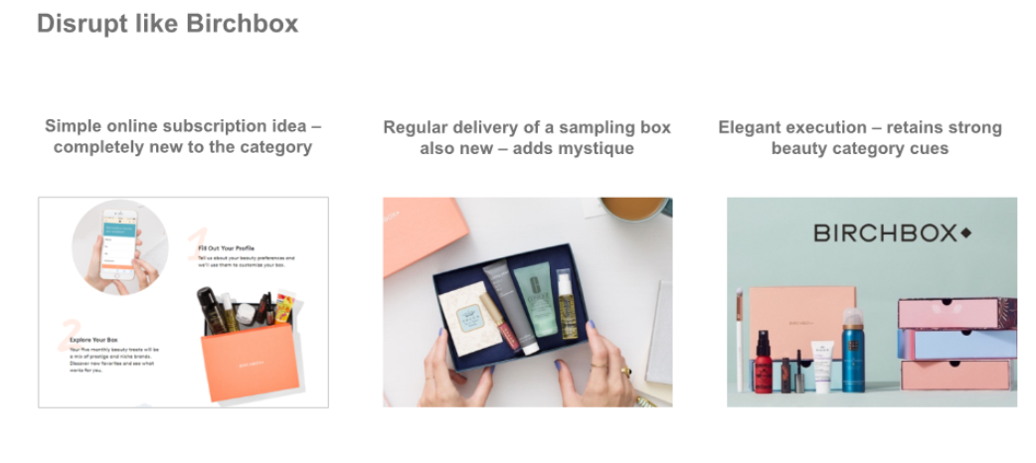
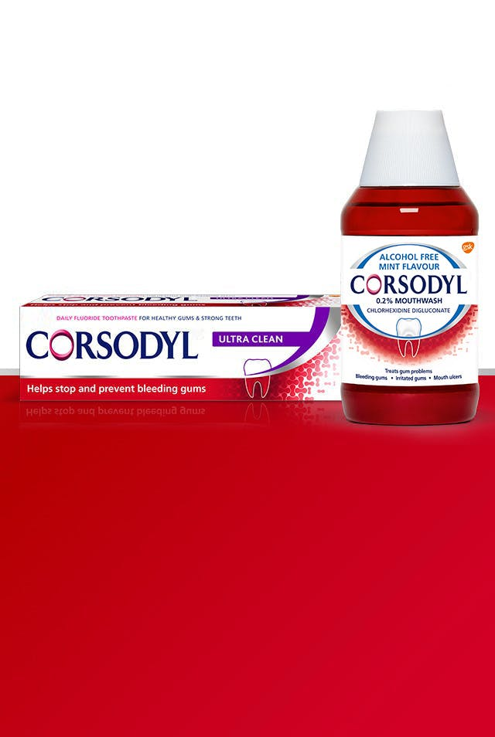
DISRUPT
Case studies How to learn from successful brands in similar situations
DISRUPT
Bring a new and unique proposition to the category and drive switching to your brand
Innovation: Be different, stand out, disrupt
Assortment: Maintain a narrow range executed excellently
In UK Corsodyl met new needs by creating a daily use product, while its media campaign meant Ultra Clean was front-of-mind with shoppers keen to take better care of their gums.
CORSODYL ULTRA CLEAN, UK Corsodyl was known for being a treatment toothpaste brand, therefore they launched a daily-use alternative, whilst maintaining its expertise.

Slide 2
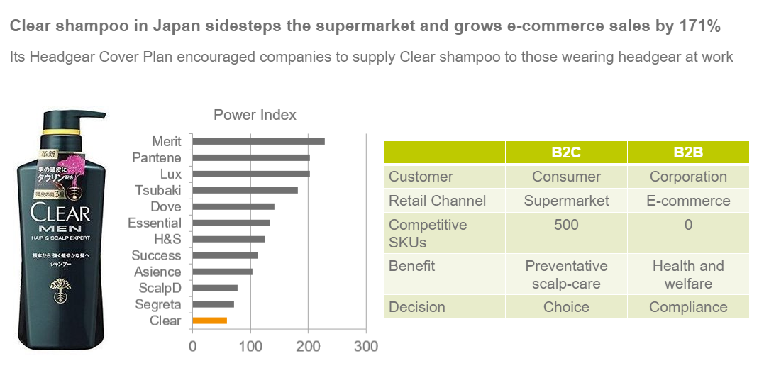
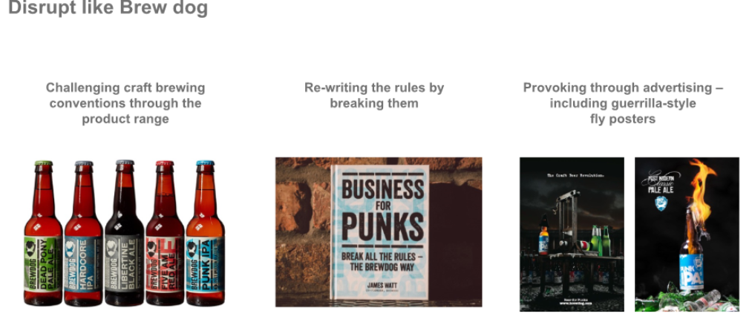
DISRUPT
Case studies How to learn from successful brands in similar situations
DISRUPT
Bring a new and unique proposition to the category and drive switching to your brand
Distribution: Break habits of consumer and retailers. Find new routes to market
Advertising: Be distinctive and avoid being all things to all people
xx

